Slide 1
KEYLOGGER
CAPSTONE PROJECT
Presented By:
B.ABISHEK - Jeppiaar Institute of Technology – B.TECH/ IT

Slide 2
OUTLINE
Problem Statement
Proposed System/Solution
System Development Approach
Algorithm & Deployment
Result
Conclusion
Future Scope
References

Slide 3
PROBLEM STATEMENT
Develop a keylogger application using Python and Tkinter GUI framework that records keystrokes and saves them into both a text file (key_log.txt) and a JSON file (key_log.json). The application should start and stop the keylogging process upon user interaction.

Slide 4
PROPOSED SOLUTION
Create a Python application using Tkinter for the GUI, pynput for listening to keyboard events, and json for saving data in JSON format. Implement functions to start and stop the keylogger, capture key press and release events, and save the recorded keystrokes into text and JSON files.

Slide 5
SYSTEM APPROACH
1.Use Tkinter to create a simple GUI with "Start" and "Stop" buttons.
2.Use pynput library to capture keyboard events.
3.Implement functions to handle key press and release events.
4.Save the recorded keystrokes into both a text file (key_log.txt) and a JSON file (key_log.json).
5.Provide functionality to start and stop the keylogging process.

Slide 6
ALGORITHM & DEPLOYMENT
.
Import required libraries: tkinter, pynput, and json.Initialize global variables keys_used, flag, and keys.Implement functions generate_text_log() and generate_json_file() to save keystrokes into text and JSON files respectively.Implement functions on_press() and on_release() to handle key press and release events.Create start_keylogger() and stop_keylogger() functions to start and stop the keylogging process.Design the Tkinter GUI with "Start" and "Stop" buttons.Configure button actions to start and stop the keylogger.Run the Tkinter main loop to display the GUI and handle user interactions.

Slide 7
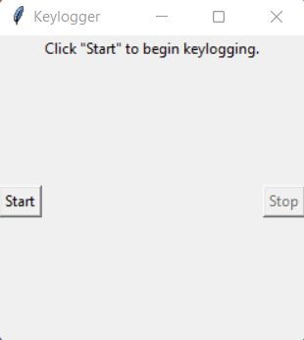
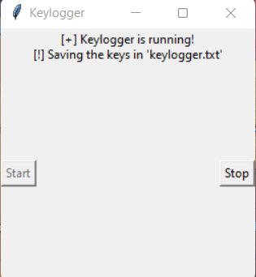
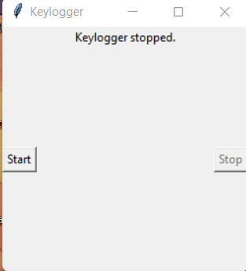
RESULT
The application will provide a simple GUI interface with "Start" and "Stop" buttons. When the user clicks "Start", the keylogger will begin recording keystrokes and save them into key_log.txt and key_log.json files. Clicking "Stop" will stop the keylogging process.

Slide 8
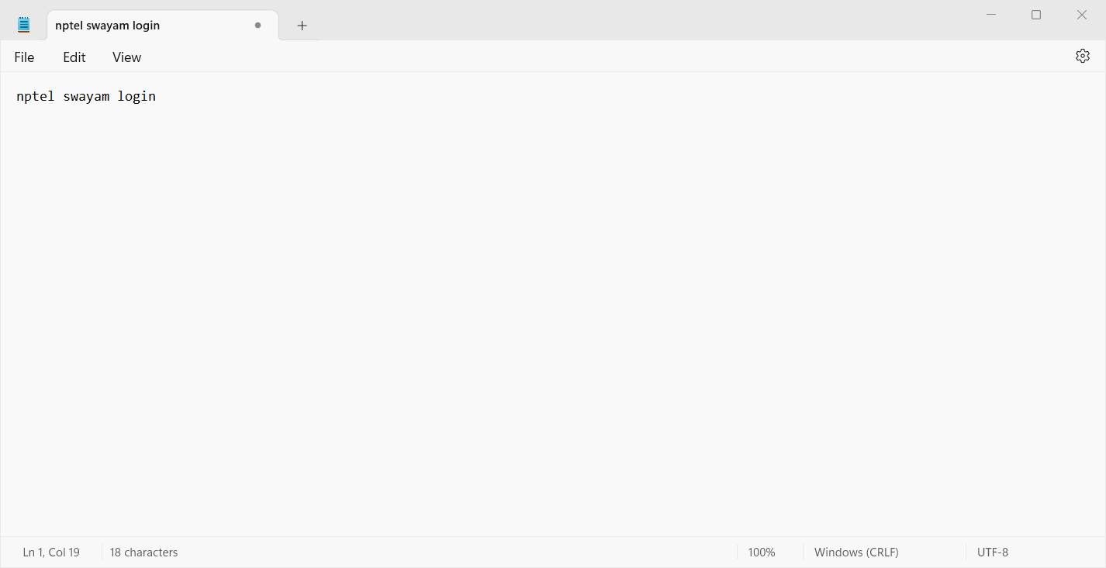
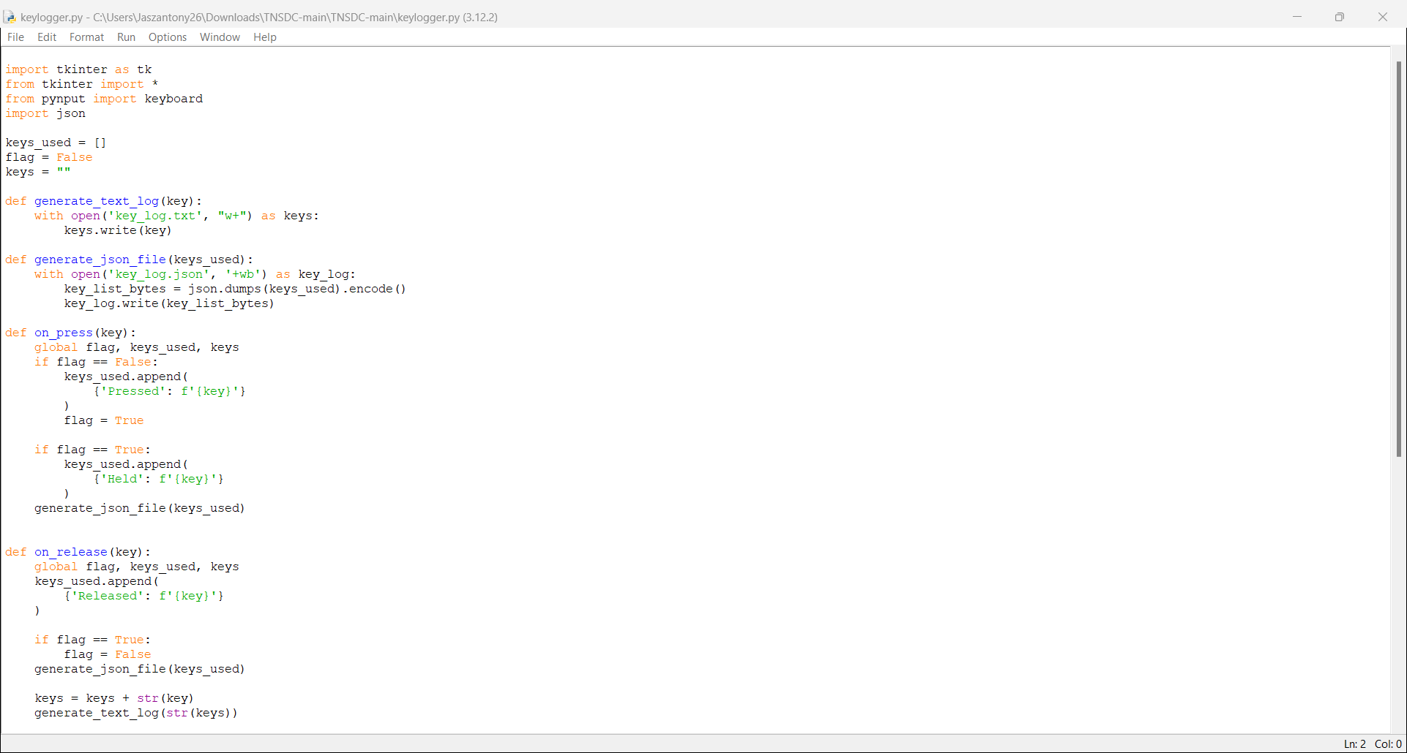
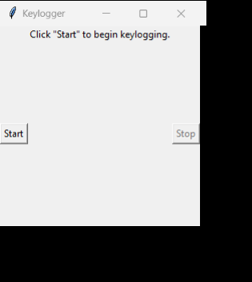
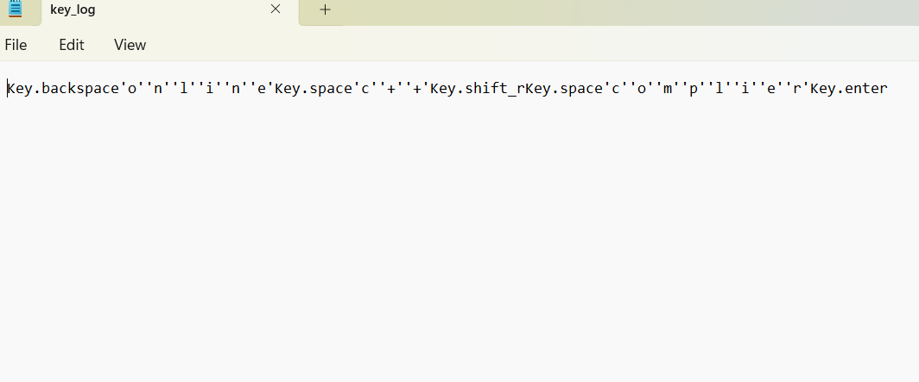
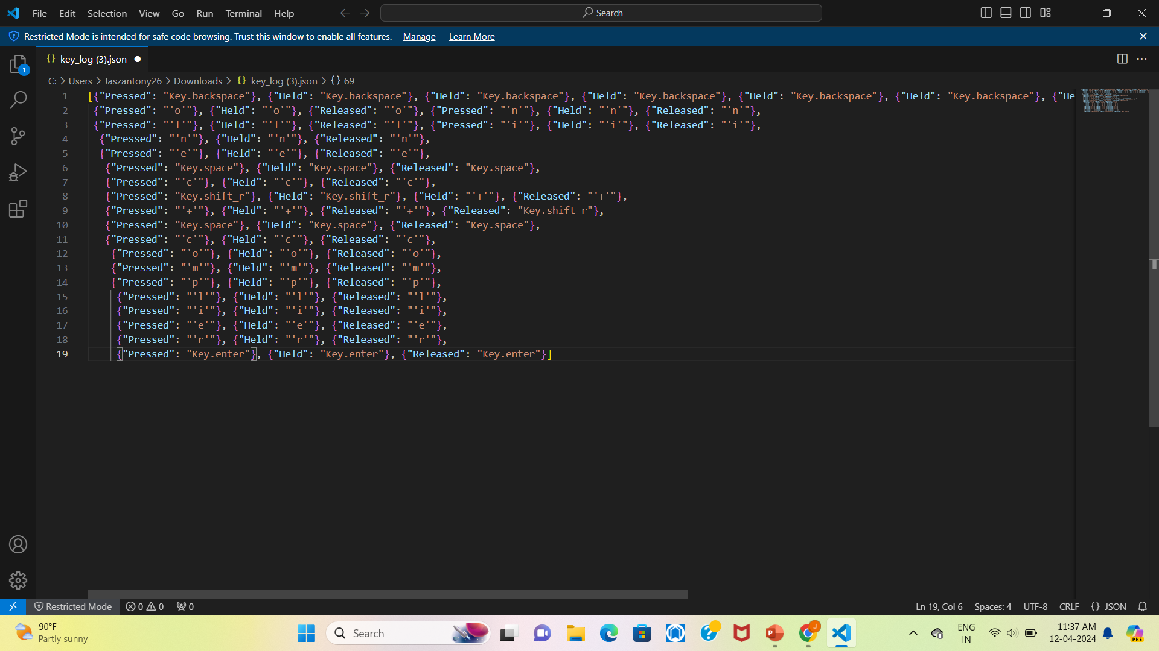
OUTPUT

Slide 9
CONCLUSION
The keylogger application successfully records keystrokes and saves them into text and JSON files. It provides a user-friendly interface for starting and stopping the keylogging process.

Slide 10
FUTURE SCOPE
Enhance the GUI with more features and customization options.
Add functionality to automatically send log files to a specified email address.
Implement encryption to secure the saved log files.
Integrate with cloud storage services for remote access to log files.

Slide 11
REFERENCES
Tkinter documentation: https://docs.python.org/3/library/tkinter.html
pynput documentation: https://pypi.org/project/pynput/
JSON documentation: https://docs.python.org/3/library/json.html

Slide 12
THANK YOU

